Slide 1
WELCOME
{CODER}in you / HTML & CSS
{CODER}
In You

Slide 2
SETUP
{CODER}in you / Setup/ Brief
ENVIRONMENT & TOOLS
Browser: Chrome
https://www.google.com/chrome/browser/desktop/index.html
Text Editor: Sublime Text 3
https://www.sublimetext.com/3
Server Connection: Sublime SFTP
https://wbond.net/sublime_packages/sftp
Code Repository: Github
https://github.com/
Acting Database: Google Spreadsheet
https://www.google.com/sheets/about/

Slide 3
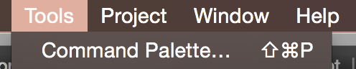
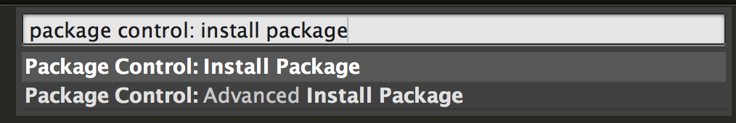
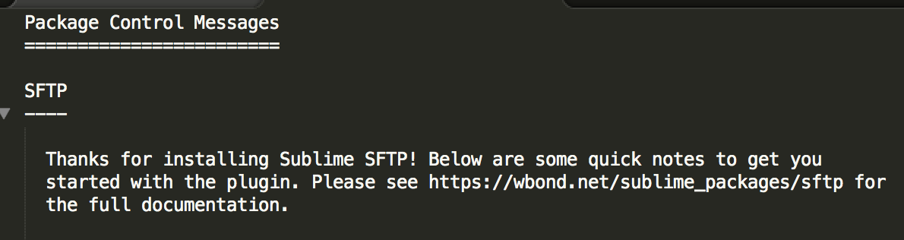
SETUP
{CODER}in you / Setup/ Brief
Setting up SFTP pt1
open sublime
open the Command Palette
type: package control: install package
click on the option and wait...
type: sftp
click on SFTP by wbond
success looks like this

Slide 4
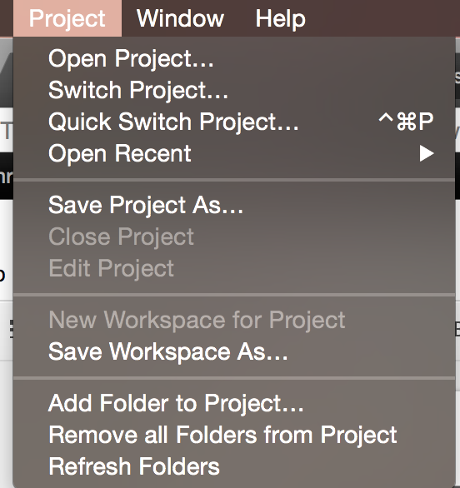
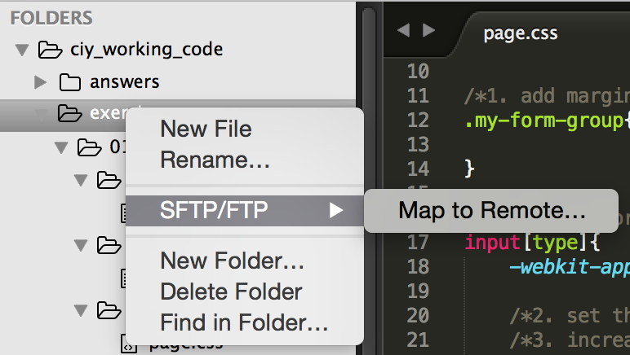
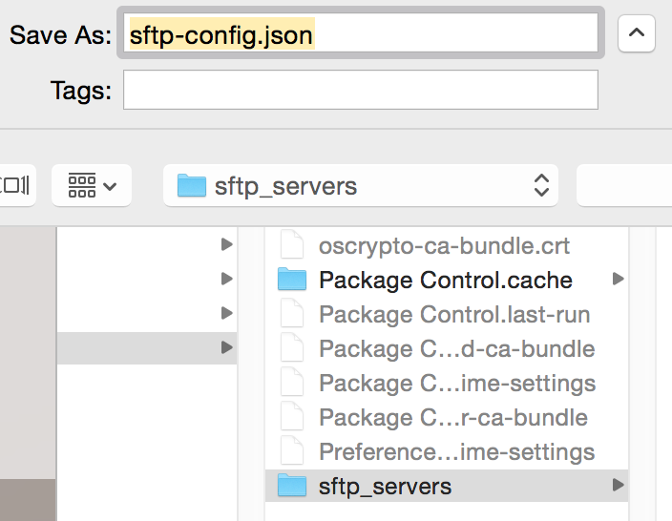
SETUP
{CODER}in you / Setup/ Brief
Setting up SFTP pt2
Download working files for today at:
https://goo.gl/1PcAIt
Unzip and place at desired location (like desktop)
In Sublime: Project > Add folder to project
select the new working file folder
a new 'sftp-config.json' will open
get the configured file
https://goo.gl/bSjhp7
replace the 'sftp-config.json' with configured file
follow the instructions in it
If successful, a message at bottom of sublime will tell you.

Slide 5
DEFINITION
{CODER}in you / HTML / Brief
HyperText
Markup
Language
Interactive text
"like clicking and images"
Tags that indicate behaviors
"I am a bold paragraph"

Slide 6
DEFINITION
{CODER}in you / CSS / Brief
Cascading
Stylesheet
Stackable in order of priority
"The 1st style made it red, 2nd one made it blue"
Describe how HTML is presented
"All headers will be red"

Slide 7
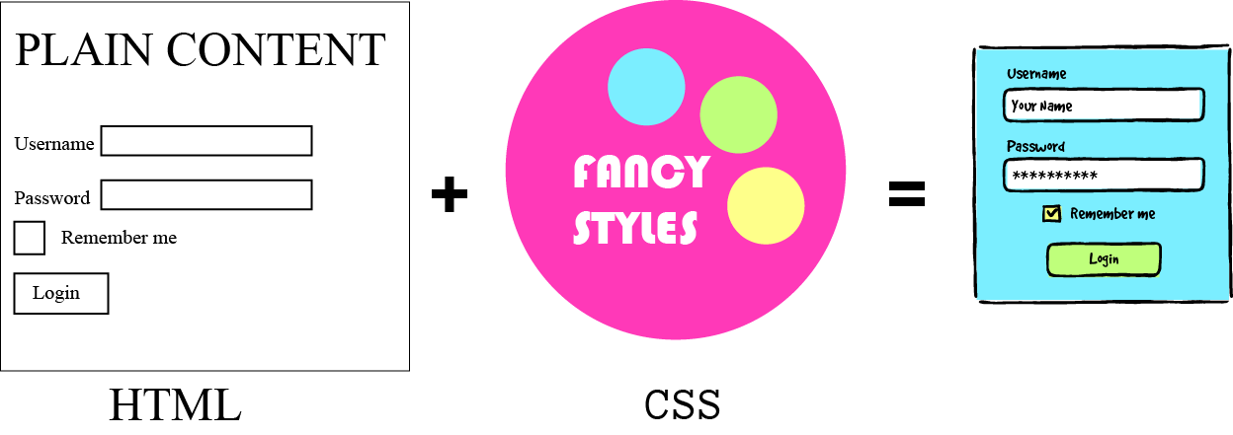
{CODER}in you / HTML / Brief
EXPERIENCE

Slide 8
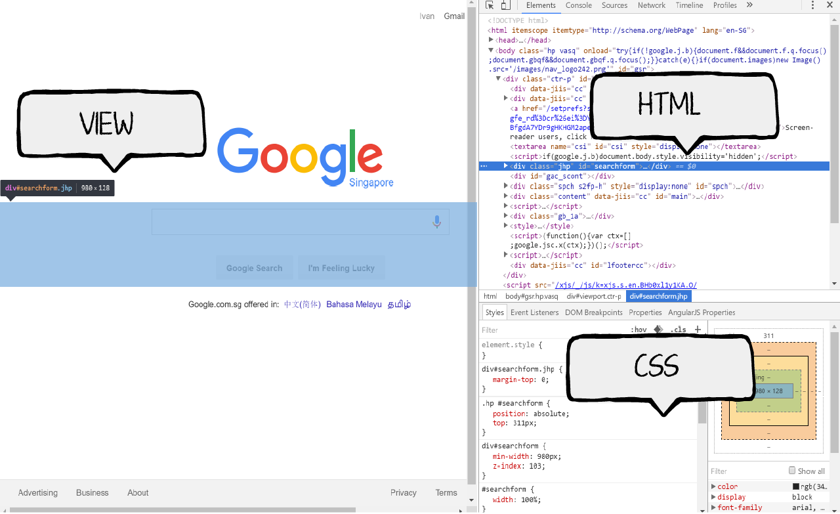
{CODER}in you / HTML / Brief
EXPERIENCE
To look at a webpage's code
Browser > Right click > Inspect

Slide 9
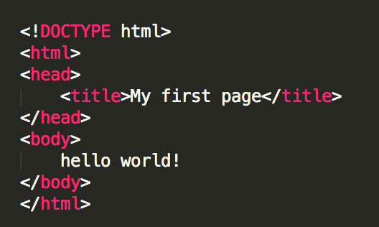
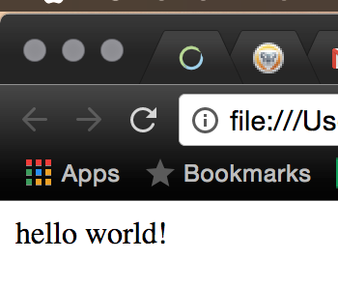
{CODER}in you / exercise / 01_basic_setup
EXPERIENCE
Setting up HTML page in sublime
Open: exercise/01_basic_setup/page.html
type: html then press 'tab' key
Fill in the <title>
Write: 'Hello World!' within <body>...</body>
open the file from your finder/explorer with chrome
success looks like this
Try loading from server:
http://play.stackup.sg/<user_name>/exercise/01_basic_setup/page.html

Slide 10

{CODER}in you / HTML / Brief
WHY IT IS IMPORTANT
How does the browser know what the information is?
If you think the internet is a series of tubes for information flow then HTML is the medium or the carrying fluid by which the information is presented and assimilated. It is the most basic block of building any webpage on the internet and everything else comes later.

Slide 11
{CODER}in you / HTML / Concepts
IS & NOT
HTML IS a language to | HTML is NOT a language to
define structure of your page What elements will go into your page? How they will be stacked? | define style of elements What is the shape, color, position or decorations for the page elements?
tell the browser about additional resources What CSS and JavaScript files are used? Where are the files located? | write actual CSS and JavaScript While it is possible to write other script languages in the HTML document, this is bad practice.

Slide 12
{CODER}in you / HTML / Concepts
WHAT IS HTML MADE OF
Plain text
<element>
Hello
<hr>
code
code
Hello
result
result

Slide 13

{CODER}in you / HTML / Concepts
WHAT IS HTML MADE OF
<element> with content
<element> with attributes
<h1>Hello</h1>
<img src="angry-cat.jpg">
code
code
Hello
result
result

Slide 14
{CODER}in you / HTML / Concepts
SYNTAX
<h1>Hello</h1>
elements are encapsulated
with sharp <brackets>
actual text content is not.
code
Hello
result

Slide 15
{CODER}in you / HTML / Concepts
SYNTAX
<h1>Hello</h1>
<hr>
text containing element has
<start> and </end>
self contained element
only has <start>
code
Hello
result

Slide 16
{CODER}in you / HTML / Concepts
SYNTAX
elements can be placed
inside other elements
this is called
NESTING
elements not nested
<h1>
Save <em>me</em> !
</h1>
<h1>Save</h1>
<em>me</em> !
code
code
Save me !
Save
me !
result
result

Slide 17
{CODER}in you / HTML / Concepts
SYNTAX
use indent to indicate nesting
wrong way
<div>
<p>hello</p>
</div>
<div>
<p>hello</p>
</div>
code
code
indent = Tab key

Slide 18
{CODER}in you / HTML / Concepts
STRUCTURE
<!doctype html>
<html lang="en">
<head>
<meta charset="utf-8">
<title>My first Webpage</title>
</head>
<body>
</body>
</html>
<!doctype html>
This tells IE that it is a html5 document
as compared to older html technology
<html>
L <head>
L <meta>
L <title>
L <body>
code
hierarchy

Slide 19
{CODER}in you / HTML / Concepts
STRUCTURE
<!doctype html>
<html lang="en">
<head>
<meta charset="utf-8">
<title>My first Webpage</title>
</head>
<body>
</body>
</html>
<html>
Everything within it is read as HTML
<html> contains <head> and <body>
lang="en" is an attribute (description)
it means language is set as english
<html>
L <head>
L <meta>
L <title>
L <body>
code
hierarchy

Slide 20
{CODER}in you / HTML / Concepts
STRUCTURE
<!doctype html>
<html lang="en">
<head>
<meta charset="utf-8">
<title>My first Webpage</title>
</head>
<body>
</body>
</html>
<head>
"The Invisible Head"
non visible content placed here
CSS & JS scripts, meta-data, title
<html>
L <head>
L <meta>
L <title>
L <body>
code
hierarchy

Slide 21
{CODER}in you / HTML / Concepts
STRUCTURE
<!doctype html>
<html lang="en">
<head>
<meta charset="utf-8">
<title>My first Webpage</title>
</head>
<body>
</body>
</html>
<meta>
Not actual content you see
Descriptions about the HTML page
Read by browser,search engine,other apps
utf-8 is an encoding (language characters)
<html>
L <head>
L <meta>
L <title>
L <body>
code
hierarchy

Slide 22
{CODER}in you / HTML / Concepts
STRUCTURE
<!doctype html>
<html lang="en">
<head>
<meta charset="utf-8">
<title>My first Webpage</title>
</head>
<body>
</body>
</html>
<title>
The name you see on the browser tab
Name for Google search result
<html>
L <head>
L <meta>
L <title>
L <body>
code
hierarchy

Slide 23
{CODER}in you / HTML / Concepts
STRUCTURE
TL;DR
HTML is for content, like text and images
CSS is for styling the HTML content
<HTML> has a <head> and <body>
invisible descriptors and scripts go into <head>
visible elements go into <body>
<element attribute="value">text content</element>

Slide 24
{CODER}in you / HTML / Concepts
STRUCTURE
7 categories of core HTML
Texts
Structural (for layouts)
Lists
Table
Image
Anchor Links
Forms

Slide 25

{CODER}in you / HTML / Concepts
TEXT
1. HEADER
2. PARAGRAPH
3. formatting

Slide 26
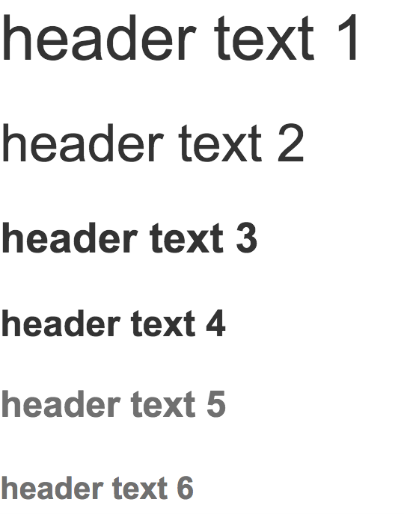
{CODER}in you / HTML / Concepts
TEXT
HEADER
<h1>header text 1</h1>
<h2>header text 2</h2>
<h3>header text 3</h3>
<h4>header text 4</h4>
<h5>header text 5</h5>
<h6>header text 6</h6>
code
result

Slide 27
{CODER}in you / HTML / Concepts
TEXT
PARAGRAPH
<p>Paragraph of text 1.</p>
<p>
Spicy jalapeno bacon ipsum dolor amet dolore eiusmod officia ground round dolor jowl bresaola ipsum pork chop qui turducken id sausage magna. Venison nulla short ribs short loin, ea jowl dolor ham hock ex id mollit.
</p>
Paragraph of text 1.
Spicy jalapeno bacon ipsum dolor amet dolore eiusmod officia ground round dolor jowl bresaola ipsum pork chop qui turducken id sausage magna. Venison nulla short ribs short loin, ea jowl dolor ham hock ex id mollit.
code
result

Slide 28
{CODER}in you / HTML / Concepts
TEXT
FORMATTING
<p>
Spicy jalapeno bacon <strong>ipsum</strong> dolor amet dolore eiusmod officia <em>ground</em> round dolor jowl bresaola
</p>
Spicy jalapeno bacon ipsum dolor amet dolore eiusmod officia ground round dolor jowl bresaola
code
result

Slide 29
{CODER}in you / HTML / Concepts
TEXT
Category | Element / Tag | Code | Description
TEXT Segment | Header / Title | <h1> ... </h1>
 | Paragraph | <p> ... </p>
 | Preformatted | <pre> ... </pre>
 | Text Block Quote | <blockquote> ... </blockquote>
TEXT format | Bold Text | <b> ... </b>
 | Italic Text | <i> ... </i>
 | Underline Text | <u> ... </u>
 | Strikeout | <strike> ... </strike>
 | Superscript | <sup> ... </sup> | Smaller text placed below normal text
 | Subscript | <sub> ... </sub> | Smaller text placed below normal text
 | Small | <small> ... </small> | Fineprint size text
 | Typewriter Text | <tt> ... </tt>
 | Strong | <strong> ... </strong> | Shown as Bold in most browsers
 | Emphasis | <em> ... </em> | Shown as Italics in most browsers

Slide 30
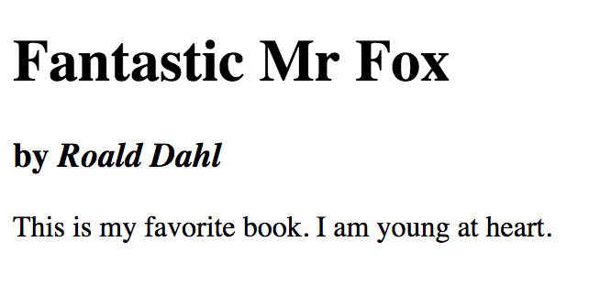
{CODER}in you / exercise / 02_01_texts
EXERCISE
Creating texts
create a <h1> title with the text: Fantastic Mr Fox
create a <h3> subtitle with the text: by Roald Dahl
Make the words 'Roald Dahl' italic by putting <em>...</em> around it
create a <p> paragraph with the text:
This is my favorite book. I am young at heart.

Slide 31
IS & NOT
{CODER}in you / CSS / Concepts
CSS IS a language to | CSS is NOT a language to
define style of elements What is the shape, color, position or decorations for the page elements? | compute data and tasks What will happen when a button is pressed? How is a list dynamically generated?
Create styles that can be recycled and overwritten Stylesheets are designed to be used across multiple elements and pages. We can avoid repeating similar codes by applying multiple styles to an element. | Apply HTML to CSS CSS styles are applied to HTML. This means that although we write CSS for HTML, where it actually makes the connection is in HTML.

Slide 32
USING CSS
{CODER}in you / CSS / Concepts
<head>
<link rel="stylesheet" href="style.css">
</head>
HTML
Stylesheet is added in the HTML <head>
rel means relationship:
what type of file?
href means hypertext-reference:
where is the file location?

Slide 33
SYNTAX
{CODER}in you / CSS / Concepts
<h1>Hello</h1>
Hello
HTML
result
h1{
background-color: black;
color: yellow;
}
To define a CSS style:
selector { style codes }
To define a style's property:
property: value ;
CSS

Slide 34
TYPES OF SELECTORS
{CODER}in you / CSS / Concepts
<p>Hello</p>
<p class="nice">Fred</p>
<p class="nice" id="nicer">
and friends.
</p>
Hello
Fred
and friends.
HTML
result
p{
background-color: yellow;
}
1. <element> selector
All elements of this type will adopt the style.
CSS

Slide 35
TYPES OF SELECTORS
{CODER}in you / CSS / Concepts
<p>Hello</p>
<p class="nice">Fred</p>
<p class="nice" id="nicer">
and friends.
</p>
Hello
Fred
and friends.
HTML
result
p{
background-color: yellow;
}
.nice{
font-weight: bold;
}
2. .class selector
All elements with this class will adopt the style. Class adds to / overrides element selectors.
CSS

Slide 36
TYPES OF SELECTORS
{CODER}in you / CSS / Concepts
<p>Hello</p>
<p class="nice">Fred</p>
<p class="nice" id="nicer">
and friends.
</p>
Hello
Fred
and friends.
HTML
result
p{
background-color: yellow;
}
.nice{
font-weight: bold;
}
#nicer{
background-color: gray;
}
3. #id selector
#id is unique to ONLY ONE element. #id style will add to / override all other styles.
Styling with #id is bad practice. It is used mainly for JavaScript.
CSS

Slide 37
CASCADING
{CODER}in you / CSS / Concepts
<head>
<link rel="stylesheet" href="style1.css">
<link rel="stylesheet" href="style2.css">
</head>
HTML
Stylesheets stack and override each other
style1 will be applied as usual.
style2 will override style1 if there are any conflicts because it is placed AFTER style1 in the HTML code.

Slide 38
CASCADING
{CODER}in you / CSS / Concepts
<p class="a b">Fred</p>
<p class="a c b">Frodo</p>
Fred
Frodo
HTML
result
.a{
font-weight: bold;
}
.b{
background-color: yellow;
}
.c{
background-color: gray;
}
Styles can stack by adding
multiple classes
Priority is decided based on CSS placement NOT HTML class
CSS

Slide 39
SUMMARY
{CODER}in you / CSS / Concepts
TL;DR
selector { property-1: value; property-2: value; }
3 basic selectors:
<element class="my-class" id="my-id">
element{ } .my-class{ } #my-id{ }
Cascading priority:
1. #id 2. .class 3. element
4. <script> placed after 5. <script> placed before
6. selector{ } placed after 7. selector{ } placed before

Slide 40
{CODER}in you / HTML / Concepts
TEXT
category | description | common properties | value | description
COLOR | text color can be used for any element | color | white | some colors have names
 |  |  | #ffffff | hex color code. original web color reference
 |  |  | rgba(255, 255, 255, 0.5) | red, green, blue - 0 to 255 alpha (opacity percentage) - 0 to 1
 | background color can be used for any element | background-color | white | some colors have names. for no color > transparent
 |  |  | #ffffff | hex color code. original web color reference
 |  |  | rgba(255, 255, 255, 0.5) | red, green, blue - 0 to 255 alpha (opacity percentage) - 0 to 1

Slide 41

TYPES OF SELECTORS
{CODER}in you / CSS / Concepts
<h1 class="my-title">Wikipedia</h1>
<h3 class="my-sub-title">The source of half truths</h3>
HTML
result
.my-title{
color: gray;
}
.my-subtitle{
color: #ffffff;
background-color: rgba(128,128,128,0.9);
}
CSS

Slide 42
{CODER}in you / HTML / Concepts
TEXT
category | description | common properties | value | description
TEXT | font display | font-family | "Roboto", sans serif | custom font in "brackets". 2nd font is used as fallback.
 |  | font-size | 16px
 |  |  | 2rem | 1rem = 12px on mobile, 16px on desktop
 |  | font-weight | 400 | increments of 100s. 100=thinest 900=thickest
 | font styling | font-style | normal | default
 |  |  | italic
 |  | text-decoration | none | default
 |  |  | underline
 |  |  | overline
 |  |  | line-through
 |  | text-shadow | 1px 1px 2px black | 1.horizontal-offset 2.vertical-offset 3.blur-amount 4.color
 | horizontal alignment | text-align | left
 |  |  | right
 |  |  | center | vertically center texts & inline tags

Slide 43

TYPES OF SELECTORS
{CODER}in you / CSS / Concepts
.my-title{
font-family: Georgia, serif;
font-size: 600px;
font-weight: 400;
text-decoration: underline;
text-shadow: 2px 2px 0 gray;
text-align: center;
}
.my-subtitle{
font-family: Arial, sans serif;
font-size: 20px;
font-weight: 600;
text-align: center;
}
<h1 class="my-title">Wikipedia</h1>
<h3 class="my-sub-title">The source of half truths</h3>
HTML
CSS
result

Slide 44
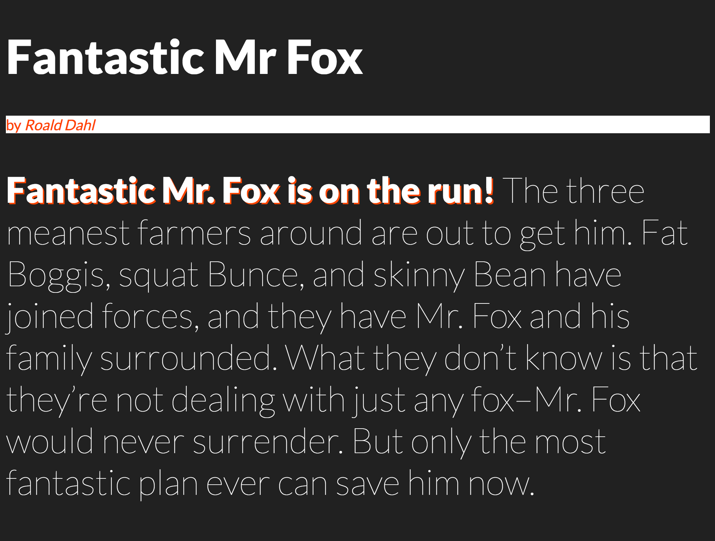
{CODER}in you / exercise / 02_02_text_style
EXERCISE
Exercise outcome
Follow the instructions in exercise/02_02_text_style
1. Start with page.html
2. Then go on to page.css

Slide 45
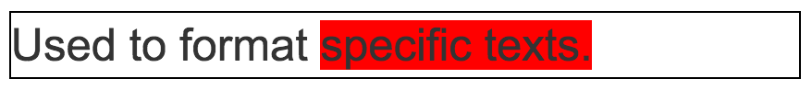
{CODER}in you / HTML / Concepts
CONTAINERS & LAYOUTS
SPAN:
wrap around words
Used to format
<span style="background-color:red;">
specific texts.
</span>
code
result

Slide 46
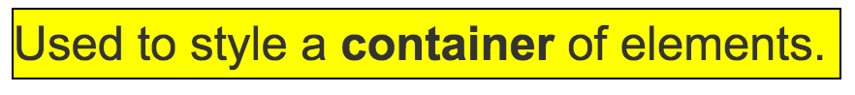
{CODER}in you / HTML / Concepts
CONTAINERS & LAYOUTS
DIV: division
used to wrap a group of content
<div style="background-color:yellow;"> Used to style a <strong>container</strong> of elements. </div>
code
result

Slide 47
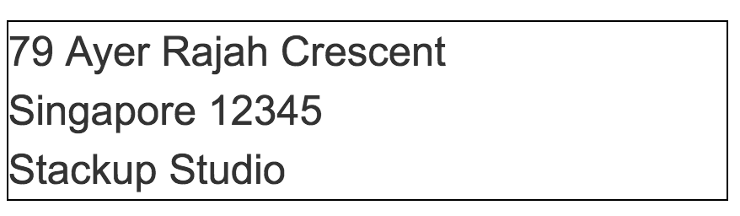
{CODER}in you / HTML / Concepts
CONTAINERS & LAYOUTS
BR: break line
create new line in same paragraph
<p>
79 Ayer Rajah Crescent<br>
Singapore 12345<br>
Stackup Studio
</p>
code
result

Slide 48
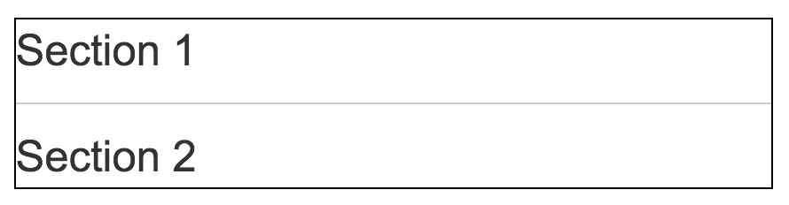
{CODER}in you / HTML / Concepts
CONTAINERS & LAYOUTS
HR: horizontal rule
create line divider
Section 1
<hr>
Section 2
code
result

Slide 49
{CODER}in you / HTML / Concepts
TEXT
Category | Element / Tag | Code | Description
Section Division | Division | <div> ... </div> | (or Section) of Page Content
 | Line Break | <br> | New line same paragraph
 | Horizontal Line | <hr> | Line across
 | Span | <span> ... </span> | Text segment

Slide 50
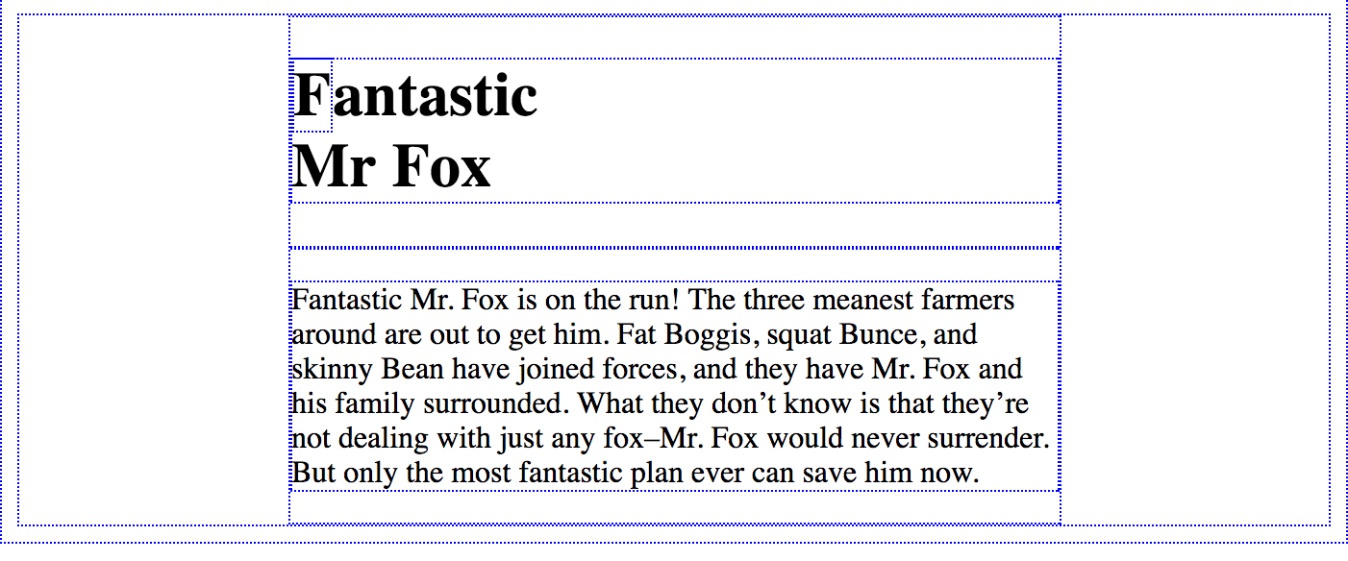
{CODER}in you / exercise / 03_01_containers
EXERCISE
Exercise outcome
Follow the instructions in exercise/03_01_containers/page.html

Slide 51

TYPES OF SELECTORS
{CODER}in you / CSS / Concepts
.my-container{
color: white;
background-color: gray;
}
<div class="my-container">
Grumpy Wizards make toxic brew for the
Evil Queen and Jack
</div>
HTML
CSS
result
coloring works same as before

Slide 52
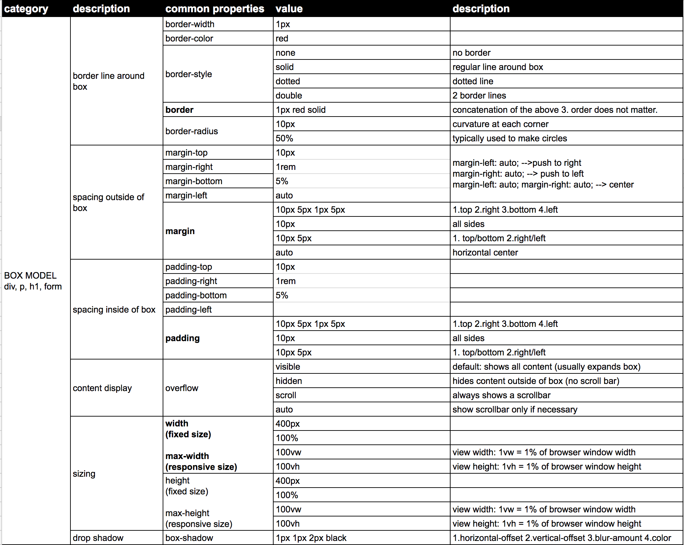
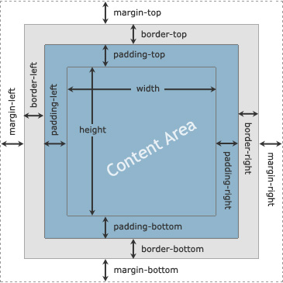
TYPES OF SELECTORS
{CODER}in you / CSS / Concepts
BOX MODEL

Slide 53

TYPES OF SELECTORS
{CODER}in you / CSS / Concepts
.my-container{
color: white;
background-color: gray;
width: 160px;
padding: 20px;
margin: 10px auto;
border: 5px dotted black;
border-radius: 10px;
box-shadow: 5px 5px 0 yellow;
}
<div class="my-container">
Grumpy Wizards make toxic brew for the
Evil Queen and Jack
</div>
HTML
CSS
result
example of a simple layout: http://codepen.io/hyperclass/pen/QdLeWb

Slide 54
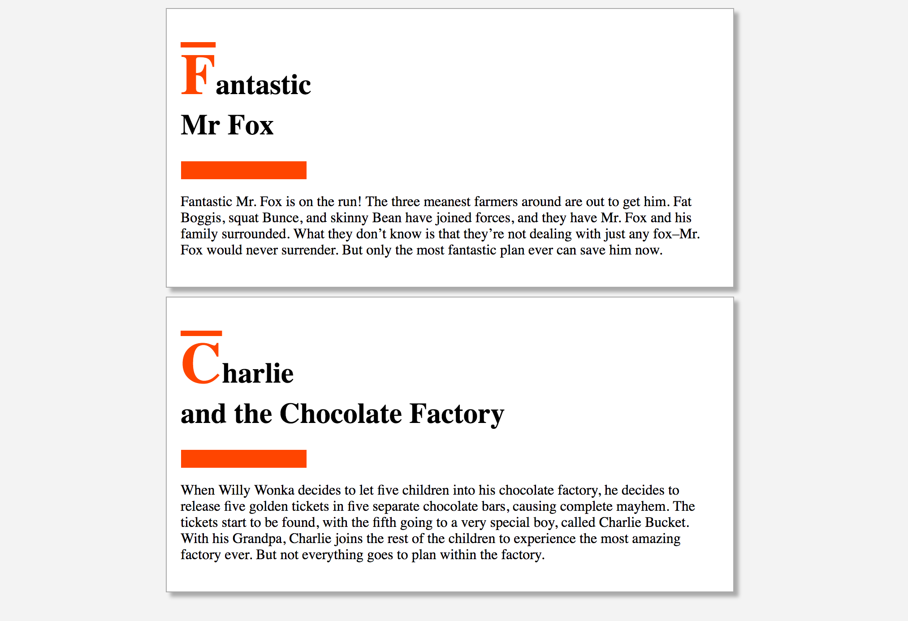
{CODER}in you / exercise / 03_02_container_style
EXERCISE
Exercise outcome
Follow the instructions in exercise/03_02_container_style/page.css

Slide 55
{CODER}in you / exercise / 02_02_text_style
EXERCISE
3 types of lists
Category | Element / Tag | Code | Description
Lists | Ordered List | <ol> ... </ol> | numbered
 | Un-ordered List | <ul> ... </ul> | bullets
 | List Item | <ul> <li> ... </li> </ul> | within ordered or unordered
 | Definition List | <dl> ... </dl>
 | Definition Term | <dl> <dt> ... </dt> </dl> | within <dl>...</dl>
 | Detailed Definition of term | <dl> <dd> ... </dd> </dl> | within <dl>...</dl>

Slide 56
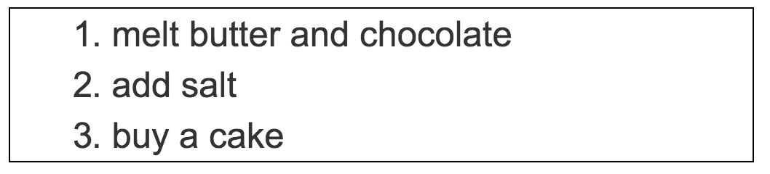
{CODER}in you / HTML / Concepts
CONTAINERS & LAYOUTS
OL: ordered list
list items are numbered
<ol>
<li>melt butter and chocolate</li>
<li>add salt</li>
<li>buy a cake</li>
</ol>
code
result

Slide 57
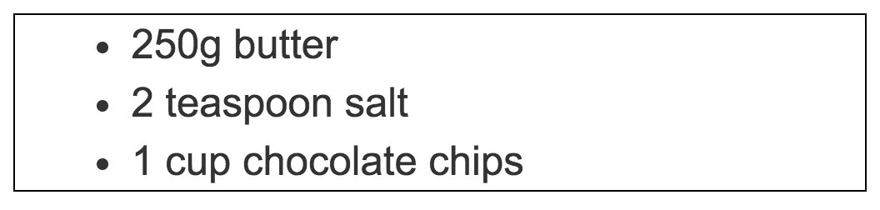
{CODER}in you / HTML / Concepts
CONTAINERS & LAYOUTS
UL: un-ordered list
list items are bulleted
<ul>
<li>250g butter</li>
<li>2 teaspoon salt</li>
<li>1 cup chocolate chips</li>
</ul>
code
result

Slide 58
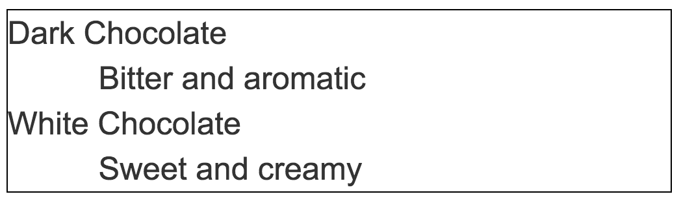
{CODER}in you / HTML / Concepts
CONTAINERS & LAYOUTS
DL: description list
title + description
<dl>
<dt>Dark Chocolate</dt>
<dd>Bitter and aromatic</dd>
<dt>White Chocolate</dt>
<dd>Sweet and creamy</dd>
</dl>
code
result

Slide 59
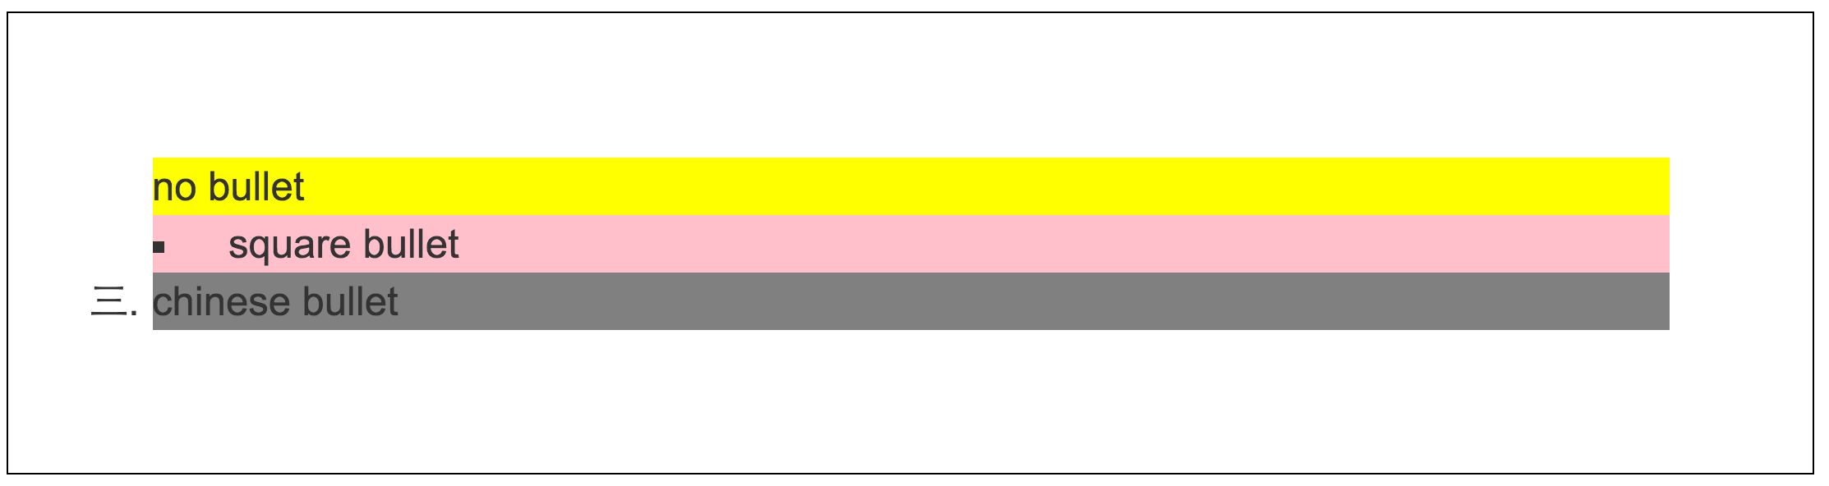
{CODER}in you / HTML / Concepts
CONTAINERS & LAYOUTS
category | description | common properties | value | description
LIST | bullet type | list-style-type | circle | full list from w3c: https://goo.gl/LxLM9i
 |  |  | upper-alpha
 |  |  | none
 | custom bullet | list-style-image | url('my-bullet.svg')
 | indent type | list-style-position | inside | bullet is grouped with text's content's CSS
 |  |  | outside | bullet is not affected by content's CSS
 | note: better to use font-awesome for customising bullets: http://fontawesome.io/examples/#list
.my-list{
padding: 50px;
list-style-type: none;
}
.item-1{
background-color: yellow;
}
.item-2{
list-style-type: square;
background-color: pink;
list-style-position:inside;
}
.item-3{
list-style-type: cjk-ideographic;
background-color: gray;
list-style-position:outside;
}
<ul class="my-list">
<li class="item-1">no bullet</li>
<li class="item-2">square bullet</li>
<li class="item-3">chinese bullet</li>
</ul>
HTML
CSS
result

Slide 60
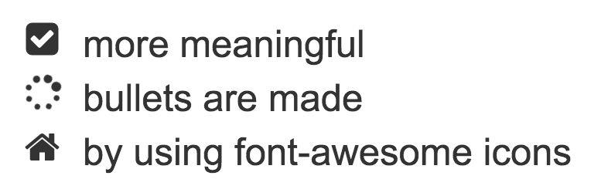
{CODER}in you / HTML / Concepts
FONT AWESOME ICON
<link rel="stylesheet" href="https://cdn.jsdelivr.net/fontawesome/4.7.0/css/font-awesome.min.css">
<ul class="fa-ul">
<li><i class="fa-li fa fa-check-square"></i>more meaningful</li>
<li><i class="fa-li fa fa-spinner fa-spin"></i>bullets are made</li>
<li><i class="fa-li fa fa-home"></i>by using font-awesome icons</li>
</ul>
FONT AWESOME
setup: add CDN code from jsDelivr
<link rel="stylesheet" href="https://cdn.jsdelivr.net/fontawesome/4.7.0/css/font-awesome.min.css">
Add the fa classes
fa: turns italic<i> into icon instead
fa-ul: unordered list
fa-li: list item
fa-home: icon name
can change with other icons
http://fontawesome.io/cheatsheet/
code
result

Slide 61

{CODER}in you / exercise / 04_01_lists
EXERCISE
Exercise outcome
Follow the instructions in exercise/04_01_lists/page.html

Slide 62
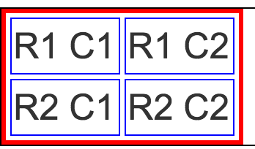
{CODER}in you / HTML / Concepts
TABLE
<table>
<tr>
<td>R1 C1</td>
<td>R1 C2</td>
</tr>
<tr>
<td>R2 C1</td>
<td>R2 C2</td>
</tr>
</table>
Category | Element / Tag | Code | Description
Table | Table | <table> ... </table>
 | Table Row | <table> <tr> ... </tr> </table> | within table
 | Table Header Cell | <table> <tr> <th> ... </th> </tr> </table> | within <tr>...</tr>
 | Table Cell | <table> <tr> <td> ... </td> </tr> </table> | within <tr>...</tr>
code
Don't bother with CSS styling for tables. Bootstrap will handle it completely for us.
result

Slide 63
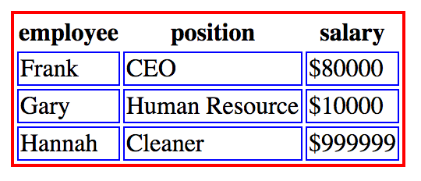
{CODER}in you / exercise / 05_01_tables
EXERCISE
Exercise outcome
Follow the instructions in exercise/05_01_tables/page.html

Slide 64

{CODER}in you / HTML / Concepts
IMAGE
<img src="http://stackup.sg/assets/stackup_logo.svg"
alt="logo">
Follow the instructions in exercise/06_01_images/page.html
code
note: only size the image with CSS. (despite what you read online)
result
Category | Element / Tag | Code | Description
Image | Image | <img src="url" alt="text"> | src: image file location
 |  |  | alt: text shown if image not available

Slide 65
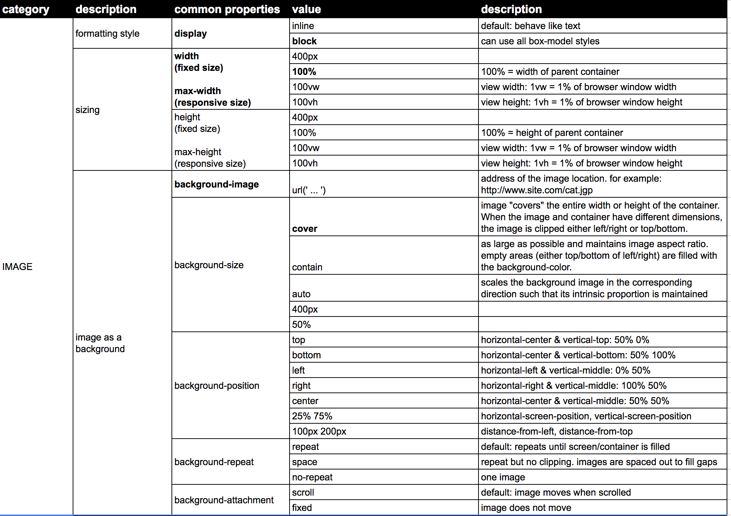
{CODER}in you / HTML / Concepts
Normal responsive image
display: block
max-width: 100%
Full screen background image:
body{
background-image: url('...');
background-size: cover;
}
IMAGE

Slide 66

IMAGE
{CODER}in you / CSS / Concepts
.my-container{
max-width: 400px;
padding: 1rem;
background-color: #212121;
margin: auto;
}
.my-title{
color: #fff;
text-align: center;
}
.my-image{
display: block;
max-width: 200px;
margin: 1rem auto;
}
<div class="my-container">
<h1 class="my-title">Welcome To</h1>
<img src="http://stackup.sg/assets/stackup_logo.svg"
alt="logo"
class="my-image">
</div>
HTML
CSS
result

Slide 67

{CODER}in you / exercise / 06_01_images
EXERCISE
Exercise outcome
Follow the instructions in exercise/06_01_images/page.css

Slide 68

IMAGE
{CODER}in you / CSS / Concepts
.my-image{
display: block; /*acts like div*/
max-width: 200px;
margin: auto;
background-color: black;
border-radius: 20px;
}
<img src="http://stackup.sg/assets/stackup_logo.svg"
alt="logo"
class="my-image">
HTML
CSS
result

Slide 69

{CODER}in you / exercise / 06_02_images_style
EXERCISE
Exercise outcome
Follow the instructions in exercise/06_02_images_style/page.css

Slide 70
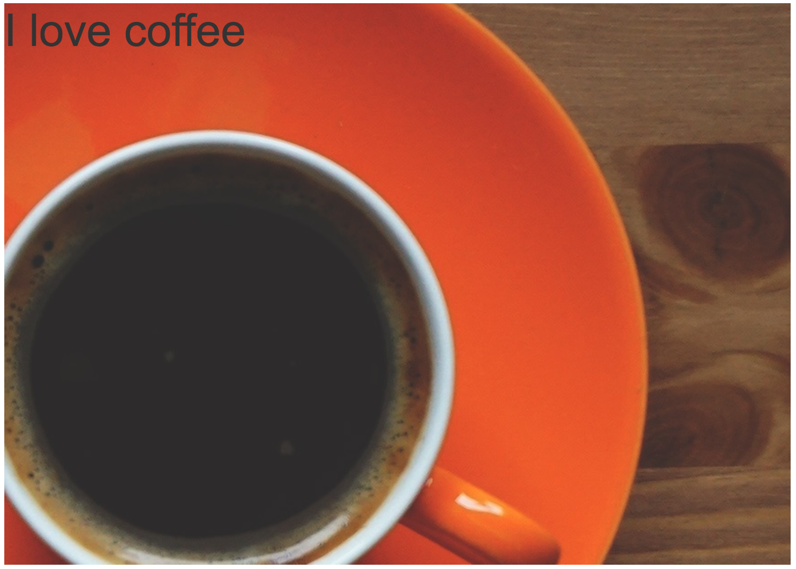
IMAGE
{CODER}in you / CSS / Concepts
.my-background-image{
background-image: url('coffee.jpg');
background-size: cover;
background-position: center;
background-repeat: no-repeat;
background-attachment: fixed;
min-height: 300px;
}
<div class="my-background-image">
<h1>I love coffee</h1>
</div>
HTML
CSS
result
SIMPLE PARALLAX EFFECT

Slide 71

{CODER}in you / exercise / 06_03_image_parallax
EXERCISE
Exercise outcome
Follow the instructions in exercise/06_03_image_parallax/page.css

Slide 72

{CODER}in you / HTML / Concepts
ANCHOR LINK
Category | Element / Tag | Code | Description
Link | Anchor Link | <a href="url" target="_blank"> link text </a> | href="http://www.x.com" (location)
 |  |  | href="mailto:xx@email.com" (email)
 |  |  | href="tel:123456789" (call)
 |  |  | target="_self" (open same window)
 |  |  | target="_blank" (open new window)
<a href="http://stackup.sg/">
link to stackup
</a>
code
result

Slide 73
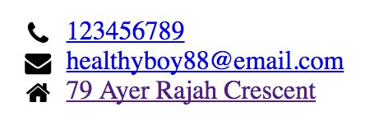
{CODER}in you / exercise / 07_01_links
EXERCISE
Exercise outcome
Follow the instructions in exercise/07_01_links/page.html

Slide 74
LINK:PSEUDO-CLASS
{CODER}in you / CSS / Concepts
selector | description | pseudo class | example
ANCHOR selectors | default state | a{ ... } | a{ color: blue; }
 | mouse hovered over | a:hover{ ... } | a:hover{ text-decoration: underline; }
 | clicking state | a:active{ ... } | a:active{ text-decoration: underline; }
 | visited link | a:visited{ ... } | a:visited{ color: purple; }
a{
background-color: green;
}
a:hover{
background-color: red;
}
a:active{
background-color: orange;
}
a:visited{
background-color:blue;
}
<a href="http://stackup.sg/">
link to stackup
</a>
HTML
http://codepen.io/hyperclass/pen/JEYdyB
CSS
result
https://developer.mozilla.org/en/docs/Web/CSS/Pseudo-classes

Slide 75
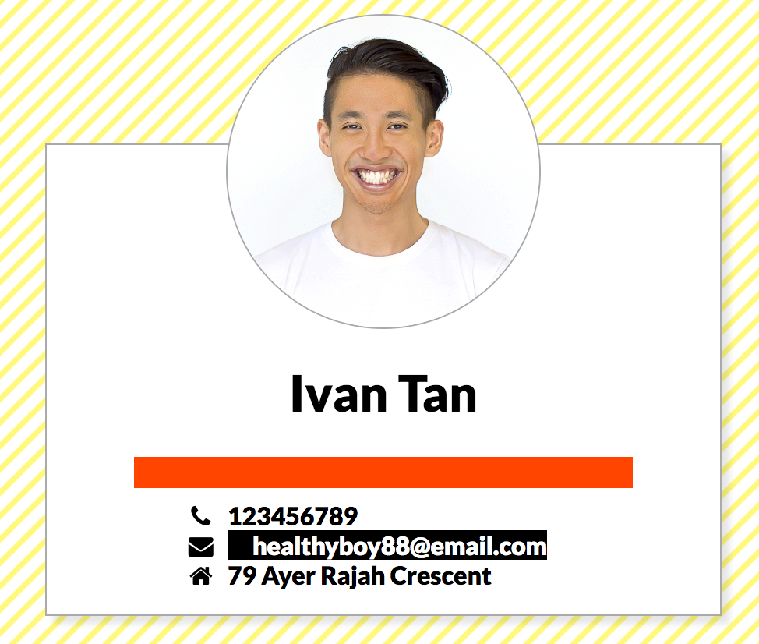
{CODER}in you / exercise / 07_02_links_style
EXERCISE
Exercise outcome
Follow the instructions in exercise/07_02_links_style/page.css

Slide 76

{CODER}in you / HTML / Concepts
EXERCISE
Category | Element / Tag | Code | Description
Form | Form | <form action="__" method="post"> ... </form> | action="http://www.x.com" (send location)
 |  |  | method="post" (http protocol)
 | Input | <form> <input type="email" name="EMAIL" value="me@site.com" maxlength="16" placeholder="type here" required> </form> | within <form> ... </form>
 |  |  | type="email" (type of input)
 |  |  | name="EMAIL" (data identifier key)
 |  |  | value="me@site.com" (data value)
 |  |  | maxlength="16" (character limit)
 |  |  | checked (defalut check for checkbox/radio)
 |  |  | placeholder="eg. frank" (helper text when empty)
 |  |  | required (required to fill)
<form action="https://coderinyou-1332.appspot.com/submit"
method="post">
<input type="text" name="user">
<input type="submit">
</form>
code
result

Slide 77
{CODER}in you / HTML / Concepts
EXERCISE
list of all the possible input types:
http://codepen.io/hyperclass/pen/WwVgbQ
Documentation of inputs and ALL attributes:
https://developer.mozilla.org/en/docs/Web/HTML/Element/input

Slide 78
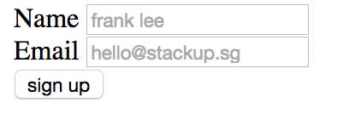
{CODER}in you / exercise / 08_01_form
EXERCISE
Exercise outcome
Follow the instructions in exercise/08_01_form/page.html

Slide 79
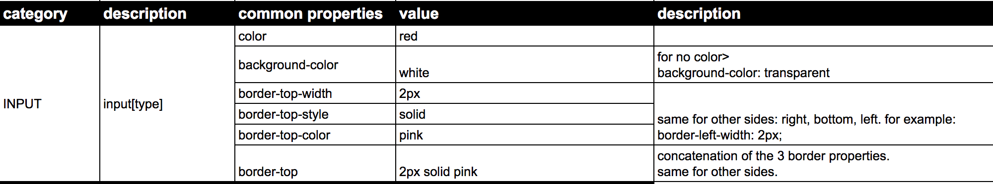
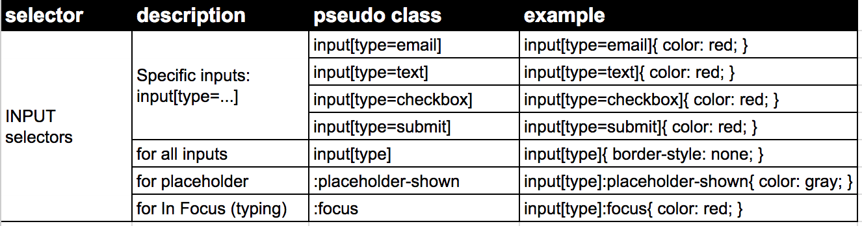
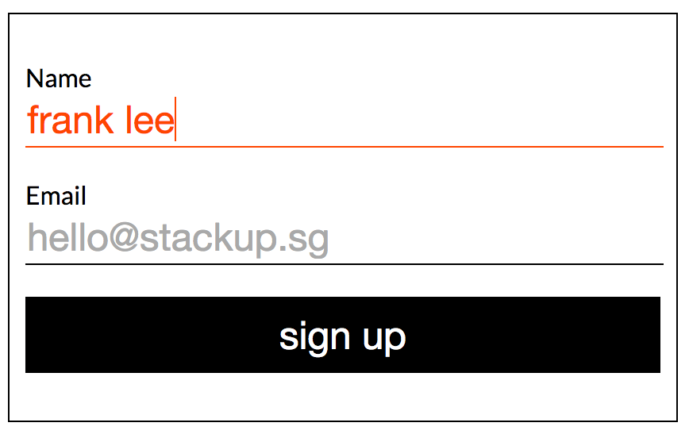
{CODER}in you / exercise / 08_02_form_style
EXERCISE
Exercise outcome
Follow the instructions in exercise/08_02_form_style/page.css

